Slide 1
Linear Control System
SATISH GUDAPATI
Assistant Professor
Department of Electrical & Electronics Engineering
Chalapathi Institute of Engineering & Technology

Slide 2
Objectives
The student will be able to:
Understand classifications of control system.
Understand Steady state, time response, and frequency response analysis.
Analyze the Stability of control system using RH criteria.

Slide 3
Module I – Introduction to Control System
Introduction to Control systems
Control System – Definition and Practical Examples
Classification of Control System : Open Loop and Closed Loop Systems – Definitions, Block diagrams, practical examples, and Comparison, Linear and Non-linear Control System, Time Varying and Time In-varying Systems
Servo System : Definition, Block Diagram, Classification (AC and DC Servo System), Block diagram of DC Servo System.
Laplace Transform and Transfer Function
Laplace Transform : Signifiance in Control System
Transfer Function : Definition, Derivation of transfer functions for Closed loop Control System and Open Loop Control System, Differential Equations and transfer functions of RC and RLC Circuit
Block Diagram Algebra
Order of a System : Definition, 0,1,2 order system Standard equation, Practical Examples
Block Diagram Reduction Technique: Need, Reduction Rules, Problems

Slide 4
Module II – Time Response Analysis
Time Domain Analysis
Transient and Steady State Response
Standard Test Inputs : Step, Ramp, Parabolic and Impulse, Need, Significance
and corresponding Laplace Representation
Poles and Zeros : Definition, S-plane representation
First and Second order Control System
First Order Control System : Analysis for step Input, Concept of Time Constant
Second Order Control System : Analysis for step input, Concept, Definition and
effect of damping
Time Response Specifications
Time Response Specifications ( no derivations )
Tp, Ts, Tr, Td, Mp, ess – problems on time response specifications
Steady State Analysis – Type 0, 1, 2 system, steady state error constants, problems

Slide 5
Module III – Stability
Introduction to Stability
Definition of Stability, Analysis of stable, unstable, critically stable
and conditionally stable
Relative Stability
Root locations in S-plane for stable and unstable system
Routh’s Stability Criterion
Routh’s Stability Criterion : Different cases and conditions
Statement Method
Numericals Problems

Slide 6
Module IV – Control Actions
Process Control System
Process Control System – Block diagram, explanation of each block
Control Actions
Discontinuous Mode : On-Off Controller, Equation, Neutral Zone
Continuous modes: Proportional Controller (offset, proportional band), Integral Controllers, Derivative Controllers – output equations, corresponding Laplace transforms, Response of P, I, D controllers
Composite Controllers : PI, PD, PID Controllers – output equations,
response, comparison

Slide 7
Module-I Introduction to Control
System

Slide 8
Specific Objectives
Explain different types of control system
Develop transfer functions
Differentiate between 1st& 2nd order of system
Develop and solve block diagram of control system

Slide 9
Module I – Introduction to Control System
Introduction to Control systems
Control System – Definition and Practical Examples
Classification of Control System : Open Loop and Closed Loop Systems – Definitions, Block diagrams, practical examples, and Comparison, Linear and Non-linear Control System, Time Varying and Time In-varying Systems
Servo System : Definition, Block Diagram, Classification (AC and DC Servo System), Block diagram of DC Servo System.
(4 Marks)
Laplace Transform and Transfer Function
Laplace Transform : Signifiance in Control System
Transfer Function : Definition, Derivation of transfer functions for Closed loop Control System and Open Loop Control System, Differential Equations and transfer functions of RC and RLC Circuit
(4 Marks)
Block Diagram Algebra (8 Marks)
Order of a System : Definition, 0,1,2 order system Standard equation, Practical Examples
Block Diagram Reduction Technique: Need, Reduction Rules, Problems

Slide 10
Input
Input
The stimulus or excitation applied to a control system from an external source in order to produce the output is called input
10

Slide 11
Output
Input
Output
The actual response obtained from a system is called output.
11

Slide 12
“System”
SYSTEM
Input
Output
A system is an arrangement of or a combination of different physical components connected or related in such a manner so as to form an entire unit to attain a certain objective.
12

Slide 13
Control
It means to regulate, direct or command a system so
that the desired objective is attained
13

Slide 14
Combining above definitions
System + Control = Control System
14

Slide 15
Control System
CONTROL SYSTEM
Input
Output
It is an arrangement of different physical elements connected in such a manner so as to regulate, direct or command itself to achieve a certain objective.
15

Slide 16
Difference between System and Control System
Input
System
Proper
Input
Control System
Desired
Output
Output
(May or may not
be desired)
16

Slide 17

Difference between System and Control System
An example : Fan
230V/50Hz
Fan (System)
Air Flow
Input
Output
AC Supply
17

Slide 18

A Fan: Can't Say System
A Fan without blades cannot be a “SYSTEM” Because it cannot provide a desired/proper output
i.e. airflow
Input Output
230V/50Hz
No Airflow
AC Supply
(No Proper/ Desired Output)
18

Slide 19
A Fan: Can be a System
A Fan with blades but without regulator can be a “SYSTEM” Because it can provide a proper output i.e. airflow
But it cannot be a “Control System” Because it cannot provide desired output i.e. controlled airflow
Input Output
230V/50Hz
Airflow
AC Supply
(Proper Output)
19

Slide 20

A Fan: Can be a Control System
A Fan with blades and with regulator can be a “CONTROL SYSTEM” Because it can provide a Desired output.
i.e. Controlled airflow
Control Element
Input
Output
230V/50Hz
Controlled Airflow
AC Supply
(Desired Output)
20

Slide 21
Module I – Introduction to Control System
Introduction to Control systems
Control System – Definition and Practical Examples
Classification of Control System : Open Loop and Closed Loop Systems – Definitions, Block diagrams, practical examples, and Comparison, Linear and Non-linear Control System, Time Varying and Time In-varying Systems
Servo System : Definition, Block Diagram, Classification (AC and DC Servo System), Block diagram of DC Servo System.
Laplace Transform and Transfer Function
Laplace Transform : Signifiance in Control System
Transfer Function : Definition, Derivation of transfer functions for Closed loop Control System and Open Loop Control System, Differential Equations and transfer functions of RC and RLC Circuit
Block Diagram Algebra
Order of a System : Definition, 0,1,2 order system Standard equation, Practical Examples
Block Diagram Reduction Technique: Need, Reduction Rules, Problems

Slide 22
Classification of Control System
Classification of Control System
(Depending on control action)
Open Loop Control System
Closed Loop Control System
22

Slide 23
Open Loop Control System
Definition:
“A system in which the control action is totally independent of the output of the system is called as open loop system”
Controlled o/p
c(t)
Reference I/p
 | Controller
Process
r(t)
u(t)
Fig. Block Diagram of Open loop Control System
23

Slide 24

OLCS Examples
Electric hand drier – Hot air (output) comes out as long as you keep your hand under the machine, irrespective of how much your hand is dried.
24

Slide 25
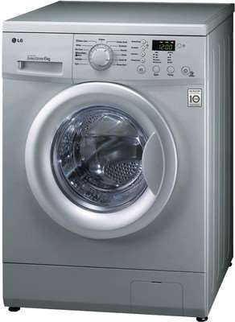
OLCS Examples
Automatic washing machine
– This machine runs according to the pre-set time irrespective of washing is completed or not.
25

Slide 26

OLCS Examples
Bread toaster | - | This
machine runs | as | per
adjusted |  | time
irrespective of toasting is completed or not.
26

Slide 27

OLCS Examples
Automatic tea/coffee Vending Machine – These machines also function for pre adjusted time only.
27

Slide 28
OLCS Examples
Light switch – lamps glow whenever light switch is on irrespective of light is required or not.
Volume on stereo system – Volume is manually irrespective of output volume level.
adjusted
28

Slide 29
Advantages of OLCS
Simple in construction and design.
Economical.
Easy to maintain.
Generally stable.
Convenient to use as output is difficult to measure.
29

Slide 30
Disadvantages of OLCS
They are inaccurate
They are unreliable
Any change in automatically.
output cannot be corrected
30

Slide 31
Closed Loop System
Definition:
“A system in which the control action is somehow dependent on the output is called as closed loop system”
31

Slide 32
Block Diagram of CLCS
Forward Path
Command
Error Signal
Manipulated
Controlled O/p
I/p
Reference Transducer
Controller
Signal
Plant
r(t)
e(t)
m(t)
c(t)
Reference I/p
Feedback
Transducer
Feedback Signal
b(t)
c(t)
Feedback Path
32

Slide 33
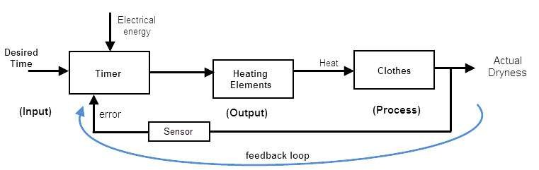

CLCS Examples
Automatic Electric Iron- Heating elements are controlled by output temperature of the iron.
33

Slide 34
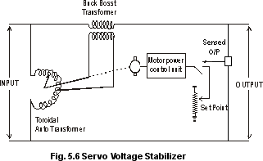
CLCS Examples
Servo voltage stabilizer – Voltage controller operates depending upon output voltage of the system.
34

Slide 35
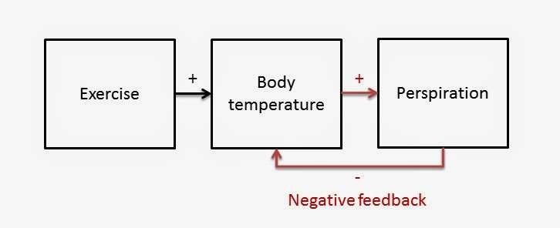
CLCS Examples
Perspiration
35

Slide 36
Advantages of CLCS
Closed loop control systems are more accurate even in the presence of non-linearity.
Highly accurate as any error arising is corrected due to presence of feedback signal.
Bandwidth range is large.
Facilitates automation.
The sensitivity of system may be made small to make system more stable.
This system is less affected by noise.
36

Slide 37
Disadvantages of CLCS
They are costlier.
They are complicated to design.
Required more maintenance.
Feedback leads to oscillatory response.
Overall gain is reduced due to presence of feedback.
Stability is the major problem and more care is needed to design a stable closed loop system.
37

Slide 38
Difference Between OLCS & CLCS
Open Loop Control System Closed Loop Control System
1. The open loop systems 1. The are simple & economical.
closed loop systems
are complex and costlier
2. They power. |  | consume | less | 2. | They power. |  | consume | more
3. | The OL | systems are |  | 3. | The | CL systems are not
 | easier | to construct |  |  | easy | to construct because
 | because | of less number |  |  | of | more number of
of components required.
components required.
4. The open loop systems are inaccurate &
4. The closed loop are accurate &
systems
more
unreliable
reliable.
38

Slide 39
Difference Between OLCS & CLCS
Open Loop Control System Closed Loop Control System
5. Stability problem systems.
is not a major in OL control
5. Stability is a major problem in closed loop systems & more care is needed to design a stable closed loop system.
Generally OL
systems are stable.
Small bandwidth.
Feedback element is absent.
Output measurement is not necessary.
Large bandwidth.
Feedback element is present.
Output measurement is necessary.
39

Slide 40
Difference Between OLCS & CLCS
Open Loop Control System Closed Loop Control System
9. The changes in the output due to external disturbances are not corrected automatically. So they are more sensitive to noise and other disturbances.
9.The changes in the output due to external disturbances are corrected automatically. So they are less sensitive to noise and other disturbances.
10. Examples:
10. Examples:
Coffee Maker,
Guided Missile,
Automatic Toaster,
Temp control of oven,
Hand Drier.
Servo voltage stabilizer.
40

Slide 41
Module I – Introduction to Control System
Introduction to Control systems
Control System – Definition and Practical Examples
Classification of Control System : Open Loop and Closed Loop Systems – Definitions, Block diagrams, practical examples, and Comparison, Linear and Non-linear Control System, Time Varying and Time In-varying Systems
Servo System : Definition, Block Diagram, Classification (AC and DC Servo System), Block diagram of DC Servo System.
Laplace Transform and Transfer Function
Laplace Transform : Signifiance in Control System
Transfer Function : Definition, Derivation of transfer functions for Closed loop Control System and Open Loop Control System, Differential Equations and transfer functions of RC and RLC Circuit
Block Diagram Algebra
Order of a System : Definition, 0,1,2 order system Standard equation, Practical Examples
Block Diagram Reduction Technique: Need, Reduction Rules, Problems

Slide 42
Classification of Control System
Classification of Control System
Linear Control System
Non-linear Control System
42

Slide 43
Linear Control System
When an input X1 produces an output Y1 & an input X2 produces an output Y2, then any
combination should produce an
α X1+ β X 2
output αY1+ βY 2 . In such case system is linear. Therefore, linear systems are those where the principles of superposition and proportionality are obeyed.
43

Slide 44
Non-linear Control System
Non-linear systems do not obey law of superposition.
The stability of non-linear systems depends on root location as well as initial conditions & type of input.
Non-linear systems exhibit self sustained oscillations of fixed frequency.
44

Slide 45
Difference Between Linear & Non-linear System
Linear System Non-linear System
Obey superposition.
Can be analyzed by standard test signals
Stability depends only on
root location
Do not obey superposition
Cannot be analyzed by standard test signals
3. Stability depends on root locations, initial conditions &
type of input
Exhibits limit cycles
Exhibits hysteresis/ jump resonance
Cannot be analyzed by Laplace transform, z- transform
Do not exhibit limit cycles
Do not exhibit hysteresis/
jump resonance
Can be analyzed by Laplace transform, z- transform
45

Slide 46
Classification of Control System
Classification of Control System
Time Varying Control System
Time Invarying Control System
46

Slide 47
Time varying/In-varying Control System
Systems whose parameters vary with time are called time varying control systems.
When parameters do not vary with time are called Time Invariant control systems.
47

Slide 48
Time varying/In-varying Control System
The mass of missile/rocket reduces as fuel is burnt and hence the parameter mass is time varying and the control system is time varying type.
48

Slide 49
Module I – Introduction to Control System
Introduction to Control systems
Control System – Definition and Practical Examples
Classification of Control System : Open Loop and Closed Loop Systems – Definitions, Block diagrams, practical examples, and Comparison, Linear and Non-linear Control System, Time Varying and Time In-varying Systems
Servo System : Definition, Block Diagram, Classification (AC and DC Servo System), Block diagram of DC Servo System.
Laplace Transform and Transfer Function
Laplace Transform : Signifiance in Control System
Transfer Function : Definition, Derivation of transfer functions for Closed loop Control System and Open Loop Control System, Differential Equations and transfer functions of RC and RLC Circuit
Block Diagram Algebra
Order of a System : Definition, 0,1,2 order system Standard equation, Practical Examples
Block Diagram Reduction Technique: Need, Reduction Rules, Problems

Slide 50
Servo System
Definition:
Servo system is defined as automatic feedback control system working on error signals giving the output as mechanical position, velocity or acceleration.
Servo system is one type of feedback control system in which control variable is the mechanical load position & its time derivatives like velocity and acceleration.
50

Slide 51
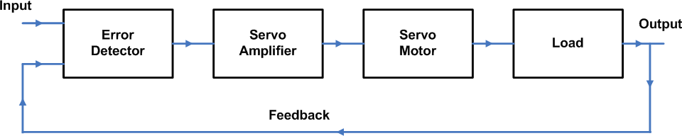
General block diagram of Servo System
51

Slide 52
Difference between Servo System
AC servo System DC servo System
Efficiency is low
Low power output
It requires less
Efficiency is high
High power output
It requires frequent
maintenance
4. Less problems
maintenance
4. More
problems
stability
stability
Smooth operation
It has non-linear
Noisy operation
It
has
linear
characteristics
characteristics
52

Slide 53
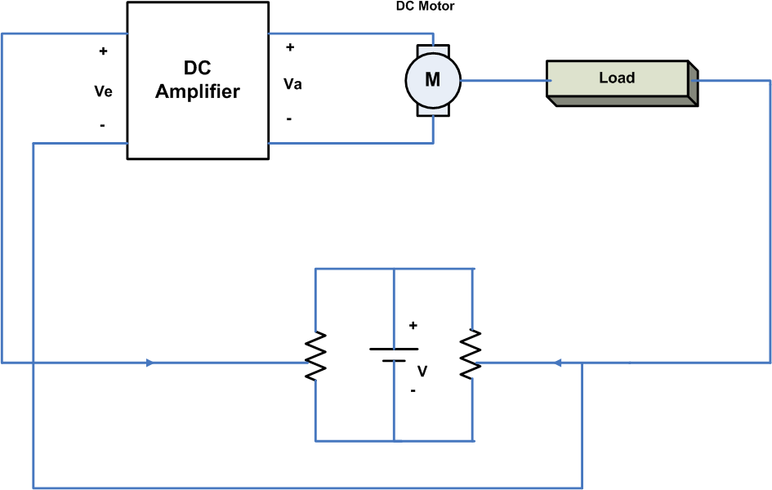
DC Servo System
53

Slide 54
DC Servo System
Working of Servo System
54

Slide 55
Module I – Introduction to Control System
Introduction to Control systems
Control System – Definition and Practical Examples
Classification of Control System : Open Loop and Closed Loop Systems – Definitions, Block diagrams, practical examples, and Comparison, Linear and Non-linear Control System, Time Varying and Time In-varying Systems
Servo System : Definition, Block Diagram, Classification (AC and DC Servo System), Block diagram of DC Servo System.
Laplace Transform and Transfer Function
Laplace Transform : Signifiance in Control System
Transfer Function : Definition, Derivation of transfer functions for Closed loop Control System and Open Loop Control System, Differential Equations and transfer functions of RC and RLC Circuit
Block Diagram Algebra
Order of a System : Definition, 0,1,2 order system Standard equation, Practical Examples
Block Diagram Reduction Technique: Need, Reduction Rules, Problems

Slide 56
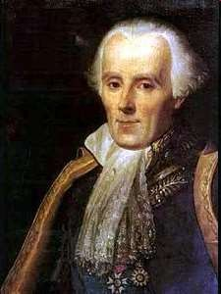
Laplace Transform
The French Newton Pierre-Simon Laplace
Developed mathematics astronomy, physics, and statistics
in
Began work in calculus which led to the Laplace Transform
Focused later on celestial
mechanics
One of suggest holes
the first scientists to the existence of black
56

Slide 57
Laplace Transform
To evaluate the performance of an automatic control
system commonly used mathematical tool is “Laplace
Transform”
Laplace transform converts the differential equation into an algebraic equation in ‘s’.
Laplace transform exist for almost all signals of practical interest.
57

Slide 58
Why Laplace Transform?
Laplace Transformation
Time domain
unknown f(t), d/dt, Diff Eqs
Solve Differential Equations
Frequency domain unknown F(s), Alg Eqs
Solve Algebraic Equations
Frequency domain known F(s)
Time domain known f(t)
Inverse Laplace Transform
58

Slide 59
Advantages of Laplace Transform
Solution of intego differential systems can be easily obtained.
equation of time
Initial conditions are automatically incorporated.
Laplace transform provides an easy & effective solution of many problems arising in automatic control systems.
Laplace transform allows the use of graphical techniques, for predicting the system performance.
59

Slide 60
Laplace Transform- Definition
The Laplace transform of a function, f(t), is defined as
[ ]
∫
∞
( )
−st
F (s) = L f (t) =
f t e
dt (1-1)
0
where F(s) is the symbol for the Laplace transform, L is the Laplace transform operator, and f(t) is some function of time, t.
Note: The L operator transforms a time domain function f(t)
into an s domain function, F(s). s is a complex variable:
s = a + bj,
j B −1
60

Slide 61
Standard Laplace Transform
f (t) F(s) = L[ f (t)]
1 or u(t)
1
s
_{e}−α t
1
s + α
ω
s² + ω ²
sinωt
cosωt
s
s² + ω ²
e^{−αt} sin ωt
ω
(s + α )² + ω ²
e^{−αt} cosωt
s + α
(s + α )² + ω ²
t
1
_{s}2
n!
_{s}n+1
_{t} n
_{e}−αt _{t}n
n!
(s + α )^{n+1}
1
δ (t)
*Use when roots are complex.
61

Slide 62
Inverse Laplace Transform
By definition, the inverse Laplace transform operator, L⁻¹, converts an s-domain function back to the corresponding time domain function:
f (t ) = L⁻¹ ⎡⎣F (s)⎤⎦
62

Slide 63
Module I – Introduction to Control System
Introduction to Control systems
Control System – Definition and Practical Examples
Classification of Control System : Open Loop and Closed Loop Systems – Definitions, Block diagrams, practical examples, and Comparison, Linear and Non-linear Control System, Time Varying and Time In-varying Systems
Servo System : Definition, Block Diagram, Classification (AC and DC Servo System), Block diagram of DC Servo System.
Laplace Transform and Transfer Function
Laplace Transform : Signifiance in Control System
Transfer Function : Definition, Derivation of transfer functions for Closed loop Control System and Open Loop Control System, Differential Equations and transfer functions of RC and RLC Circuit
Block Diagram Algebra
Order of a System : Definition, 0,1,2 order system Standard equation, Practical Examples
Block Diagram Reduction Technique: Need, Reduction Rules, Problems

Slide 64
Transfer Function
The relationship between input & output of a system is
given by the transfer function.
Definition: The ratio of Laplace transform of the output to the Laplace transform of the input under the assumption of zero initial conditions is defined as
“Transfer Function”.
64

Slide 65
Transfer Function
System g(t)
LT
System G(s)
r(t)
c(t)
R(s)
C(s)
For the system shown,
c(t)= output r(t)= input
g(t)= System function
L{c(t)}= C(s)
L{r(t)}= R(s)
L{g(t)}= G(s)
Therefore transfer function G(s) for above system is given by,
Laplace of output ₌
C (s)
R(s)
G(s)=
Laplace of input
65

Slide 66
Transfer Function of closed loop system
Error Signal E(s)
Gain for CL system is given by;
G(s) = ^{C(s)}
E(s)
∴C(s) = G(s).E(s) − − − − − −(3)
R(s)
C(s)
Output
+₋
G(s)
Input
Substitute value of E(s) from eq. 1 to 3
C(s) = G(s).(R(s) − B(s))
∴C(s) = G(s).R(s) − G(s).B(s) − − − − − −(4)
B(s)
H(s)
Feedback Signal
Substitute value of B(s) from eq. 2 to 4
C(s) = G(s) R(s) − G(s).H(s).C(s)
G(s).R(s) = C(s) + G(s).H(s).C(s)
G(s).R(s) = C(s)(1 + G(s).H(s))
Transfer function is given by;
Error signal is given by;
E(s) = R(s) − B(s) − − − − − (1)
∴ R(s) = E(s) + B(s)
Gain of feedback network is given by;
H (s) = ^{B(s)}
C(s) G(s)
C(s)
B ( s ) = H (s).C(s) − − − − − −(2)
T.F.=
=
R(s) 1 + G(s).H(s) ₇₀

Slide 67
Laplace Transform of Passive Element (R,L & C)
The Laplace transform can be used independently on
different circuit elements, and then the circuit can be solved entirely in the S Domain (Which is much easier).
Let's take a look at some of the circuit elements
67

Slide 68
Laplace Transform of R
Resistors are time and frequency invariant. Therefore, the transform of a resistor is the same as the resistance of the resistor.
L{Resistor}=R(s)
68

Slide 69
Laplace Transform of C
Let us look at the relationship between voltage, current, and capacitance, in the time domain:
i(t) = C ^{dv(t)}
dt
Solving for voltage, we get the following integral:
₁ ∞
v(t) = ∫i(t) dt
C
to
Then, transforming this equation into the Laplace domain, we get the following:
V (s) = ¹ ¹ I (s)
C s
69

Slide 70
Laplace Transform of C
Again, if we solve for the ratio V(s)/I(s), we get the following:
V (s) ₌ 1
I (s) sC
Therefore, the transform capacitance C is given by:
for a capacitor with
1
L{capacitor} =
sC
70

Slide 71
Laplace Transform of L
Let us look at the relationship between voltage, current, and inductance, in the time domain:
v(t) = L ^{di(t)}
dt
putting this into the Laplace domain, we get the formula:
V (s) = sLI(s)
And solving for our ratio
V (s) _{= sL} I(s)
71

Slide 72
Laplace Transform of L
Therefore, the transform of an inductor with inductance L is given by:
L{inductor} = sL
72

Slide 73

Transfer Function of RC and RLC electrical circuits
Example: Find the TF of given RC network
Taking Laplace transform above equation
Vo(s) = ¹ I (s) − − − − − −(2)
C
Vi(t)
i(t)
Vo(t)
sC
∴ I (s) = sC.Vo(s) − − − − − −(3)
From equation 1,
Vi(s) = I (s)(R+ ¹ ) − − − − − −(4)
Apply KVL for input loop,
1
t
vi(t) = Ri(t) + ∫i(t)dt
C
sC
From equation 3 and 4,
0
Taking Laplace transform above equation
Vi(s) = RI(s) + ¹ I (s) − − − − − −(1)
sC
Apply KVL for output loop,
t
1 ₎
Vi(s) = Vo(s).sC.(R+
sC
1
vo(t) = ∫i(t)dt C
73
0

Slide 74
Vo(s) ₌
1
Transfer Function= G(s)=
Vi(s)
sC.(R+ ¹ )
sC
Vo(s) ₌
1
Vi(s)
_{sC.(} sCR + 1
)
sC
Vo(s) ₌ 1
Vi(s)
sCR + 1
1
sCR + 1
Vi(s)
Vo(s)
74

Slide 75

Transfer Function of RC and RLC electrical circuits
Example: Find the TF of given RLC network
L
Apply KVL for input loop,
C
Vi(t)
i(t)
Vo(t)
1
Vi(s) = RI(s) + sLI(s) +
I (s)
sC
Taking Laplace transform above network ₁
∴Vi(s) = [R+ sL+ ]I (s) − − − − − − − (1)
sC
sL
Apply KVL for output loop,
1
sC
Vi(s)
I(s)
Vo(s)
1
Vo(s) =
I (s) − − − − − −(2)
sC
75

Slide 76
From equation 1 and 2,
Transfer Function=
1
Vo(s) ₌
Vi(s)
I (s)
sC
[R+ sL+ ¹ ] I(s)
sC
1
₌ sC
[R+ sL+
1 ]
sC
1
₌ sC sCR + s² LC + 1
sC
1
=
sCR + s² LC + 1
1
=
s² LC + sCR +1
80

Slide 77
Module I – Introduction to Control System
Introduction to Control systems
Control System – Definition and Practical Examples
Classification of Control System : Open Loop and Closed Loop Systems – Definitions, Block diagrams, practical examples, and Comparison, Linear and Non-linear Control System, Time Varying and Time In-varying Systems
Servo System : Definition, Block Diagram, Classification (AC and DC Servo System), Block diagram of DC Servo System.
Laplace Transform and Transfer Function
Laplace Transform : Signifiance in Control System
Transfer Function : Definition, Derivation of transfer functions for Closed loop Control System and Open Loop Control System, Differential Equations and transfer functions of RC and RLC Circuit
Block Diagram Algebra
Order of a System : Definition, 0,1,2 order system Standard equation, Practical Examples
Block Diagram Reduction Technique: Need, Reduction Rules, Problems

Slide 78
Order of System
The order of control system is defined as the highest power of s present in denominator of closed loop transfer function G(s) of unity feedback system.
78

Slide 79
Example1: Determine order of given system
s(s+ 2)
TF = G(s) =
_{s}4
+ 7s³ +10s² + 5s + 5
79

Slide 80
Example1: Determine order of given system
s(s+ 2)
TF = G(s) =
_{s}4
+ 7s³ +10s² + 5s + 5
Answer: The highest power of equation in denominator of given transfer function is ‘4’.
Hence the order of given system is fourth
80

Slide 81
System Order and Proper System
Highest power of s present in denominator of closed
loop transfer function is called as “Order of System”.
A proper system is a system where the degree of the denominator is larger than or equal to the degree of the numerator polynomial.
81

Slide 82
Example 2 : Determine order of given system
_{G(s) =} (s+ 5)(s+ 2)
s(s+ 3)(s+ 4)
82

Slide 83
Example 2 : Determine order of given system
_{G(s) =} (s+ 5)(s+ 2)
s(s+ 3)(s+ 4)
Solution: To obtain highest power of denominator,
Simplify denominator polynomial.
s(s+ 3)(s+ 4) = 0
s(s² + 7 s+ 12) = 0
s³ + 7s² +12s = 0
The highest power of equation in denominator of given transfer function is ‘3’. Hence given system is “Third Order system”.
The degree of denominator is larger than the numerator hence system is “Proper System”
83

Slide 84
Example 3 : Determine order of given system
K(s+ 5)
G(s) =
s³ (7 s² + 12s + 5)
84

Slide 85
Example 3 : Determine order of given system
K(s+ 5)
G(s) =
s³ (7 s² + 12s + 5)
Solution: To obtain highest power of denominator,
Simplify denominator polynomial.
s³ (7s² +12s + 5) = 0
7s⁵ +12s⁴ + 5s³ = 0
The highest power of equation in denominator of given transfer function is ‘5’. Hence given system is “Fifth Order system”.
The degree of denominator is larger than the numerator hence system is “Proper System”
85

Slide 86
Types of System
(depending on highest power of denominator)
Zero (0) Order System
First Order System
Second Order System
86

Slide 87
Zero (0) Order System
Definition: If highest power of complex variable ‘s’ present in Characteristics equation is zero, then it is called as
“Zero order System”
1
1 + T
R(s)
+
C(s)
-
87

Slide 88
Zero (0) Order System
Consider a unity feedback system with transfer function
1
G(s) =
1 + T
Hence characteristics equation is given by,
1+ T = 0
1+ s⁰T = 0
or
Here the highest power of s is equal to 0,
Hence the system given above is zero order system.
Practical Example: Amplifier type control system
88

Slide 89
First Order System
Definition: If highest power of complex variable ‘s’ present In Characteristics equation is one, then it is called as
“First order System”
1
1 + sCR
+
R(s)
C(s)
-
89

Slide 90
First Order System
Consider a unity feedback system with transfer function
1
G(s) =
1 + sCR
Hence characteristics equation is given by,
1+ sCR = 0
Here the highest power of s is equal to 1,
Hence the system given above is First order system.
Practical Example: RC circuits, thermal type systems
90

Slide 91
Second Order System
Definition: If highest power of complex variable ‘s’ present In Characteristics equation is two, then it is called as “Second order System”
1
s² LC + sCR +1
R(s)
+
C(s)
-
91

Slide 92
Second Order System
Consider a unity feedback system with transfer function
1
G(s) =
s² LC + sCR + 1
Hence characteristics equation is given by,
s² LC + sCR +1 = 0
Here the highest power of s is equal to 2,
Hence the system given above is Second order system.
Practical Example: RLC circuits, Robotic control system.
92

Slide 93
Module I – Introduction to Control System
Introduction to Control systems
Control System – Definition and Practical Examples
Classification of Control System : Open Loop and Closed Loop Systems – Definitions, Block diagrams, practical examples, and Comparison, Linear and Non-linear Control System, Time Varying and Time In-varying Systems
Servo System : Definition, Block Diagram, Classification (AC and DC Servo System), Block diagram of DC Servo System.
Laplace Transform and Transfer Function
Laplace Transform : Signifiance in Control System
Transfer Function : Definition, Derivation of transfer functions for Closed loop Control System and Open Loop Control System, Differential Equations and transfer functions of RC and RLC Circuit
Block Diagram Algebra
Order of a System : Definition, 0,1,2 order system Standard equation, Practical Examples
Block Diagram Reduction Technique: Need, Reduction Rules, Problems

Slide 94
Need of Block Diagram Algebra
If the system is simple & has limited parameters then it
is easy to analyze such systems using the methods discussed earlier i.e. transfer function, if the system is complicated and also have number of parameters then it is very difficult to analyze it.

Slide 95
Need of Block Diagram Algebra
To overcome this problem representation method is used.
block
diagram
It is a simple way to represent any practically complicated system. In this each component of the system is represented by a separate block known as functional block.
These blocks are interconnected in a proper sequence.

Slide 96
Block Diagram Fundamentals
Block Diagram: It is shorthand, pictorial representation
of the cause and effect relationship between input and output of a physical system.
BLOCK
Input
Output

Slide 97
Block Diagram Fundamentals
Output: The value of the input is multiplied to the value of block gain to get the output.
3s
X(s)
Y(s)
Output
Y(s)= 3s. X(s)

Slide 98
Block Diagram Fundamentals
Summing Point: Two or more signals can be added/ substracted at summing point.
y
+
x
output
+
Output =x+y-z
-
z

Slide 99
Block Diagram Fundamentals
Take off Point: The output signal can be applied to two or more points from a take off point.
Z
Z
Z
Take off point
Z
103

Slide 100
Block Diagram Fundamentals
Forward Path: The direction of flow of signal is from input to output
Forward Path
R(s) +
C(s)
G1
G2
-
H1
Feedback Path
Feedback Path: The direction of flow of signal is from output to input

Slide 101
Block Diagram Reduction Techniques
Rule 1: For blocks in cascade
Gain of blocks connected in cascade gets multiplied with each other.
R(s)
R1(s) _{G2}
C(s)
R(s)
G1G2
C(s)
G1
R1(s)=G1R(s)
C(s)= G1G2R(s)
C(s) =G2R1(s)
=G1G2R(s)

Slide 102
R(s)
G1
G2
G3
C(s)
Find Equivalent
R(s)
G1G2G3
C(s)

Slide 103
R(s)
G1
G2
G3
C(s)
R1(s)
Find Equivalent
R(s)
C(s)
R(s)
G1G2
G3
C(s)
G1G2G3
R1(s)
107

Slide 104
Block Diagram Reduction Techniques
Rule 2: For blocks in Parallel
Gain of blocks connected in parallel gets added algebraically.
G1
R1(s)
+
R(s)
R(s)
G2
R2(s) ⁻
C(s)
G1-G2+G3
C(s)
+
G3
R3(s)
C(s)= R1(s)-R2(s)+R3(s)
= G1R(s)-G2R(s)+G3R(s)
C(s)=(G1-G2+G3) R(s)
C(s)= (G1-G2+G3) R(s)

Slide 105
Block Diagram Reduction Techniques
Rule 3: Eliminate Feedback Loop
R(s)
+
C(s)
E(s)
G
₊-
R(s)
G
1 ± GH
C(s)
B(s)
H
C(s)
G
=
In General
R(s)
1 ± GH

Slide 106
From Shown Figure,
E(s) = R(s) − B(s)
C(s) = G.E(s)
= G[R(s) − B(s)]
= GR(s) − GB(s)
and
R(s)
C(s)
+₋
E(s)
G
But
B(s)
H
B(s) = H.C(s)
∴C(s) = G.R(s) − G.H.C(s)
C(s) + G.H = GR(s)
∴C(s){1+ G.H} = G.R(s)
∴ C(s) ₌ G R(s) 1 + GH
For Negative Feedback

Slide 107
From Shown Figure,
E(s) = R(s) + B(s)
and
C(s) = G.E(s)
= G[R(s) + B(s)]
= GR(s) + GB(s)
B(s) = H.C(s)
∴C(s) = G.R(s) + G.H.C(s)
R(s)
C(s)
+₊
E(s)
G
But
B(s)
H
C(s) − G.H = GR(s)
∴C(s){1− G.H} = G.R(s)
∴ C(s) ₌ G R(s) 1 − GH
For Positive Feedback
111

Slide 108
Block Diagram Reduction Techniques
Rule 4: Associative Law for Summing Points
The order of summing points can be changed if two or more summing points are in series
R(s) ⁺
_{X} +
C(s)
R(s) +
_{X} +
C(s)
-
-
B2
X=R(s)-B2
B1
X=R(s)-B1
C(s)=X-B2
B2
B1
C(s)=X-B1 C(s)=R(s)-B2-B1
C(s)=R(s)-B1-B2

Slide 109
Block Diagram Reduction Techniques
Rule 5: Shift summing point before block
R(s)
G
+
C(s)
R(s) +
C(s)
G
+
+
X
1/G
X
C(s)=R(s)G+X
C(s)=G{R(s)+X/G}
=GR(s)+X

Slide 110
Block Diagram Reduction Techniques
Rule 6: Shift summing point after block
R(s) +
G
C(s)
R(s)
G
+
C(s)
+
+
G
X
X
C(s)=G{R(s)+X}
=GR(s)+GX
C(s)=GR(s)+XG
=GR(s)+XG

Slide 111
Block Diagram Reduction Techniques
Rule 7: Shift a take off point before block
R(s)
G
C(s)
R(s)
G
C(s)
G
X
X
C(s)=GR(s)
and X=C(s)=GR(s)
C(s)=GR(s)
and X=GR(s)

Slide 112
Block Diagram Reduction Techniques
Rule 8: Shift a take off point after block
R(s)
G
C(s)
R(s)
G
C(s)
1/G
X
X
C(s)=GR(s)
and X=C(s).{1/G}
=GR(s).{1/G}
= R(s)
C(s)=GR(s)
and X=R(s)
116

Slide 113
Block Diagram Reduction Techniques
While solving block diagram for getting single block
equivalent, the said rules need to be applied. After each simplification a decision needs to be taken. For each decision we suggest preferences as

Slide 114
Block Diagram Reduction Techniques
First Choice
First Preference:
Rule 1 (For series)
Second Preference:
Rule 2 (For parallel)
Third Preference:
Rule 3 (For FB loop)

Slide 115
Block Diagram Reduction Techniques
Second Choice
(Equal Preference)
Rule 4 Adjusting summing order
Rule 5/6 Shifting summing point before/after block Rule7/8 Shifting take off point before/after block

Slide 116
Example 1
G4
+
R(s) ⁺
+
G1
G2
G3
+
C(s)
G6
-
-
+
H1
G5
H2

Slide 117
Rule 1 cannot be used as there are no immediate series blocks.
Hence Rule 2 can be applied to G4, G3, G5 in parallel to get an equivalent of G3+G4+G5

Slide 118
Example 1
cont….
Apply Rule 2
Blocks in Parallel
G4
+
R(s) ⁺
+
G1
G2
G3
+
C(s)
G6
-
-
+
H1
G5
H2

Slide 119
Example 1
cont….
Apply Rule 1
Blocks in series
R(s) +
+
G1
G2
C(s)
G3+G4+G5
G6
-
-
H1
H2

Slide 120
Example 1
cont….
Apply Rule 3
Elimination of feedback loop
R(s)
+
+
G1
C(s)
G2(G3+G4+G5)
G6
-
-
H1
H2

Slide 121
Example 1
cont….
Apply Rule 1
Blocks in series
G1
1 + G1H1
R(s) +
C(s)
G2(G3+G4+G5)
G6
-
H2

Slide 122
Example 1
cont….
Apply Rule 3
Elimination of feedback loop
G1G2(G 3 + G 4 + G 5) 1 + G1H1
R(s) ⁺
G6
C(s)
-
H2

Slide 123
Example 1
cont….
Apply Rule 1
Blocks in series
G1G2(G 3 + G 4 + G 5)
1 + G1H1 + G1G2H 2(G 3 + G 4 + G 5)
C(s)
R(s)
G6

Slide 124
Example 1
cont….
G1G2G6(G 3 + G 4 + G 5)
1 + G1H1 + G1G2H 2(G 3 + G 4 + G 5)
R(s)
C(s)

Slide 125
Example 1
cont….
C (s) ₌
G1G2G6(G 3 + G 4 + G 5)
R(s)
1 + G1H1 + G1G2H 2(G 3 + G 4 + G 5)

Slide 126
Example 2
G4
+
R(s) +
+
G1
G2
G3
+
C(s)
+
-
H1
H2

Slide 127
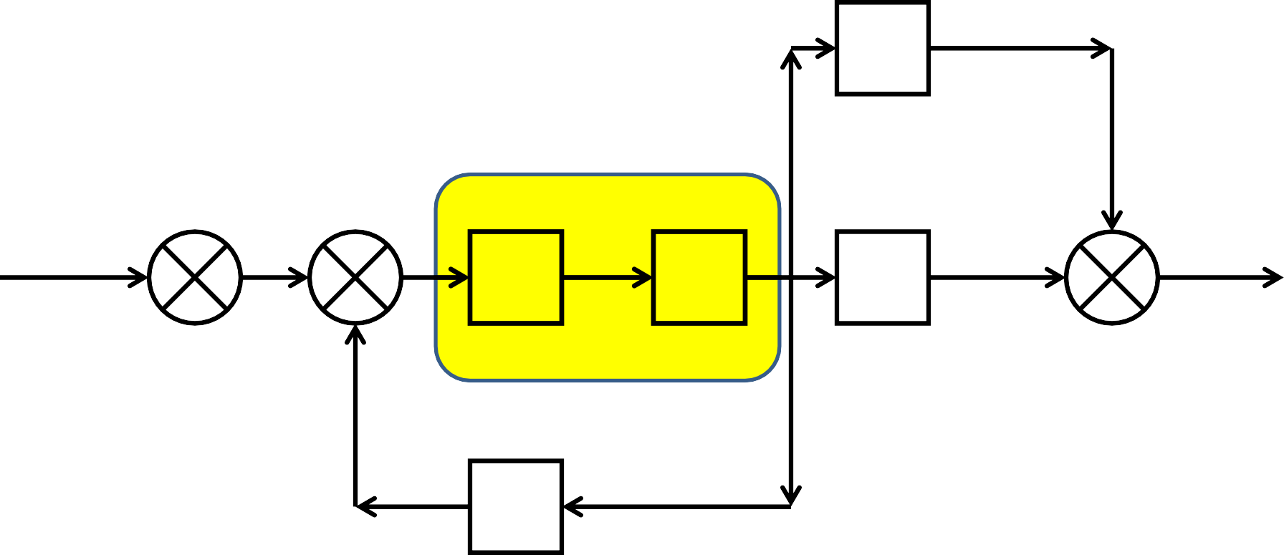
Example 2
cont….
Apply Rule 1 Blocks in series
G4
+
R(s) +
+
+
C(s)
G1
G2
G3
+
-
H1
H2

Slide 128
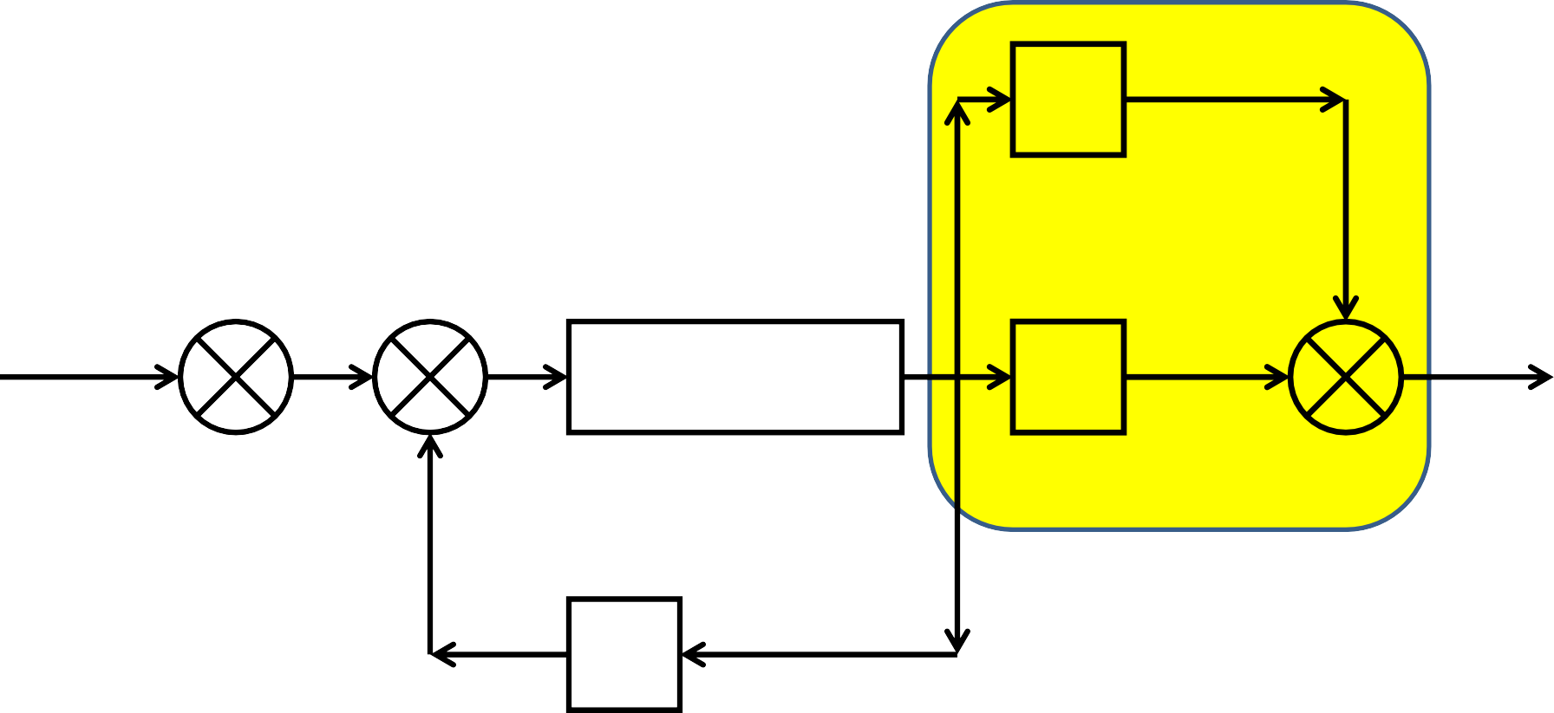
Example 2
cont….
Apply Rule 2 Blocks in parallel
G4
+
R(s) +
+
+
C(s)
G1G2
G3
+
-
H1
H2

Slide 129
Example 2
cont….
Apply Rule 3
Elimination of feedback loop
R(s) +
+
G1G2
G3+G4
C(s)
+
-
H1
H2

Slide 130
Example 2
cont….
Apply Rule 2
Blocks in series
G1G2
1 + G1G2H1
R(s) +
G3+G4
C(s)
+
H2

Slide 131
Example 2
cont….
Apply Rule 3
Elimination of feedback loop
G1G2(G 3 + G 4) 1 + G1G2H1
R(s) +
C(s)
+
H2

Slide 132
Example 2
cont….
G1G2(G 3 + G 4)
1 + G1G2H1 − G1G2G3H 2 − G1G2G4H 2
R(s)
C(s)

Slide 133
Example 2
cont….
C(s) ₌
G1G2(G 3 + G 4)
R(s)
1 + G1G2H1 − G1G2G3H 2 − G1G2G4H 2

Slide 134
Example 3
G5
+
R(s) +
G1
+
G2
G3
+
G4
C(s)
-
-
H1
H2

Slide 135
Example 3
cont….
Apply Rule 3
Elimination of feedback loop
G5
+
R(s) +
G1
+
G2
G3
+
G4
C(s)
-
-
H1
H2

Slide 136
Example 3
cont….
Apply Rule 1
Blocks in series
G5
+
G2
1 + G2H1
R(s) +
G1
G3
+
G4
C(s)
-
H2

Slide 137
Example 3
cont….
Apply Rule 2
Blocks in parallel
G5
+
G1G2G3 1 + G2H1
R(s) +
+
G4
C(s)
-
H2

Slide 138
Example 3
cont….
Apply Rule 1 Blocks in series
_{G5 +} G1G2G3
R(s) +
G4
C(s)
1 + G2H1
-
H2

Slide 139
Example 3
cont….
Apply Rule 3
Elimination of feedback loop
R(s) +
C(s)
G 4(G5 + ^{G1G2G3} )
1 + G2H1
-
H2

Slide 140
Example 3
cont….
G4G5 + G2G4G5H1 + G1G2G3G4
1+ G2H1+ G4G5H 2 + G2G4G5H1H 2 + G1G2G3G4H 2
R(s)
C(s)

Slide 141
Example 3
cont….
C(s) ₌
G4G5 + G2G4G5H1 + G1G2G3G4
R(s)
1 + G2H1 + G4G5H 2 + G2G4G5H1H 2 + G1G2G3G4H 2

Slide 142
Example 4
R(s) +
+
-
+
C(s)
G1
G2
-
-
H1
H2

Slide 143
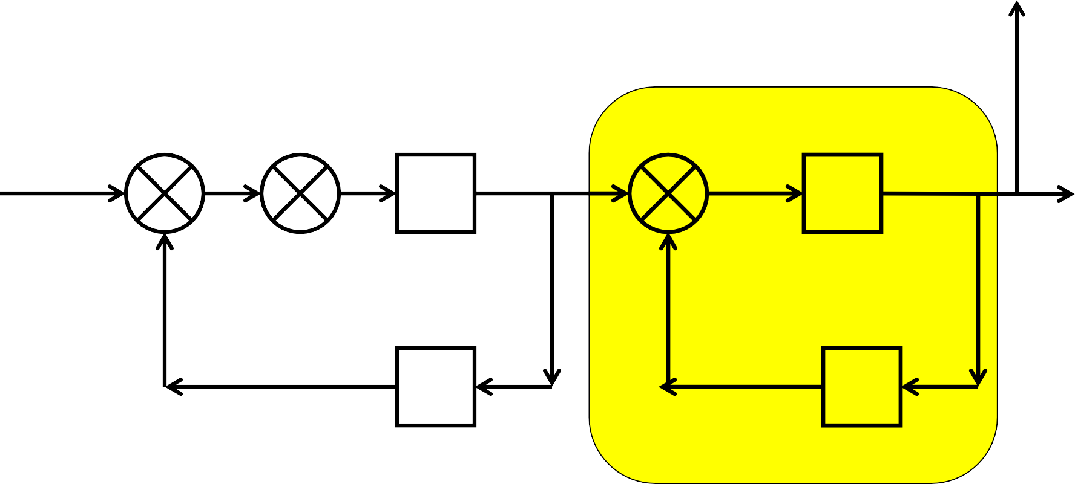
Example 4
cont….
Apply Rule 3
Elimination of feedback loop
-
R(s) +
+
+
C(s)
G1
G2
-
-
H1
H2

Slide 144
Example 4
cont….
G2
1 + G2H 2
R(s) +
+
-
C(s)
G1
-
H1

Slide 145
Now Rule 1, 2 or 3 cannot be used directly.
There are possible ways of going ahead.
Use Rule 4 & interchange order of summing so that Rule 3 can be used on G.H1 loop.
b. Shift take off point after
G2
block reduce
1 + G2H 2
by Rule 1, followed by Rule 3.
Which option we have to use????

Slide 146
Example 4
cont….
Apply Rule 4
Exchange summing order
1
R(s) +
2
G2
1 + G2H 2
+
-
C(s)
G1
-
H1

Slide 147
Example 4
cont….
Apply Rule 3 Elimination feedback loop
1
G2
1 + G2H 2
2
R(s) +
-
+
G1
C(s)
-
H1

Slide 148
Example 4
cont….
Apply Rule 1 Bocks in series
G1
1 + G1H1
G2
1 + G2H 2
2
R(s) +
-
C(s)

Slide 149
Example 4
cont….
G1G2
1 + G1H1 + G2H 2 + G1G2H1H 2
2
R(s) +
-
C(s)
Now which Rule will be applied
-------It is blocks in parallel
-------It is feed back loop
OR

Slide 150
Example 4
cont….
Let us rearrange the block diagram to understand Apply Rule 3 Elimination of feed back loop
G1G2
1 + G1H1 + G2H 2 + G1G2H1H 2
2
R(s) +
C(s)
-

Slide 151
Example 4
cont….
G1G2
1 + G1H1 + G2H 2 + G1G2H1H 2 + G1G2
R(s)
C(s)

Slide 152
Example 4
cont….
C(s) ₌
G1G2
R(s)
1 + G1H1 + G2H 2 + G1G2H1H 2 + G1G2

Slide 153
Note 1: According to Rule 4
By corollary, one can split a summing point to two summing point and sum in any order
B
B
+
R(s) +
G
C(s)
+
+ ₊
R(s)
G
C(s)
-
-
H
H

Slide 154
Example 5
Simplify, by splitting second summing point as
said in note 1
H1
-
R(s) +
+
G1
G2
G3
C(s)
-
-
H2
H3

Slide 155
Example 5
cont….
Apply rule 3
Elimination of feedback loop
H1
+
+
+
-
C(s)
G1
G2
G3
R(s)
-
-
H2
H3

Slide 156
Example 5
cont….
Apply rule 1
Blocks in series
+
G1
1 + G1H1
+
G2
G3
C(s)
R(s)
-
-
H2
H3

Slide 157
Example 5
cont….
Apply rule 3
Elimination of feedback loop
G1G2
1 + G1H1
+
+
G3
R(s)
-
C(s)
-
H2
H3

Slide 158
Example 5
cont….
Apply rule 1
Blocks in series
G1G2
1 + G1H1 + G1G2H 2
+
G3
C(s)
R(s)
-
H3

Slide 159
Example 5
cont….
Apply rule 3
Elimination of feedback loop
G1G2G3
1 + G1H1 + G1G2H 2
+
R(s)
C(s)
-
H3

Slide 160
Example 5
cont….
G1G2G3
1 + G1H1 + G1G2H 2 + G1G2G3H 3
R(s)
C(s)

Slide 161
Example 5
cont….
C(s) ₌
G1G2G3
R(s)
1 + G1H1 + G1G2H 2 + G1G2G3H 3

Slide 162

Example 6
Apply rule 8
Shift take off point beyond block G3
G5
+
R(s) +
G1
+
G2
G3
G4
+
C(s)
-
-
H1
H2

Slide 163
Example 6
cont….
Apply rule 1 Blocks in series
1/ G3
G5
+
R(s) +
G1
+
G2
G3
G4
+
C(s)
-
-
H1
H2

Slide 164
Example 6
cont….
Apply rule 2 Blocks in parallel
G5/ G3
+
R(s) +
G1
+
G2G3
G4
+
C(s)
-
-
H1
H2

Slide 165
Example 6
cont….
Apply rule 3 Feedback loop
G4+(G5/
G3)
R(s) +
G1
+
G2G3
C(s)
-
-
H1
H2

Slide 166
Example 6
cont….
Apply rule 1 Blocks in series
G4+(G5/
G3)
R(s) +
G1
G2G3
C(s)
1+ G2G3H1
-
H2

Slide 167
Example 6
cont….
R(s) +
G2G3
C(s)
(G1)(
)(G 4 + ^{G5})
1+ G2G3H1
G3
-
H2

Slide 168
Example 6
cont….
G2G3
= (G1)(
)(G 4 + ^{G5})
1+ G2G3H1
G3
G2G3
₎₍G 4G3 + G5₎
= (G1)(
1+ G2G3H1 G3
₌ G1G2(G 4 G 3 + G 5) 1 + G2G3H1

Slide 169
Example 6
cont….
Apply rule 3
Feedback loop
G1G2(G 4 G 3 + G 5) 1 + G2G3H1
R(s) +
C(s)
-
H2

Slide 170
Example 6
cont….
 | G1G2(G 4 G 3 + G 5)
1 + G2G3H1 + G1G2H 2(G 3G 4 + G 5)
C(s)
R(s)

Slide 171
Example 6
cont….
C(S) ₌
G1G2(G 4 G 3 + G 5)
R(S)
1 + G2G3H1 + G1G2H 2(G 3G 4 + G 5)

Slide 172
Example 7
Apply rule 8
Shift take off point after block G4
H2
-
R(s) +
G1
+
G2
+
G3
G4
-
-
C(s)
H3
H1

Slide 173
Example 7
cont….
Apply rule 1
Blocks in series
H2
1/G4
-
R(s) +
G1
+
G2
+
G3
G4
-
-
C(s)
H3
H1

Slide 174
Example 7
cont….
Apply rule 3
Feedback loop
H2/
G4
-
R(s) +
G1
+
G2
+
G3G4
-
-
C(s)
H3
H1

Slide 175
Example 7
cont….
Apply rule 1
Blocks in series
H2/
G4
-
R(s) +
+
G3G4
1 + G3G4H 3
G1
G2
-
C(s)
H1

Slide 176
Example 7
cont….
Apply rule 3
Feedback loop
H2/ G4
-
G2G3G4 1 + G3G4H 3
R(s) +
G1
+
-
C(s)
H1

Slide 177
Example 7
cont….
Apply rule 1
Blocks in series
G2G3G4
1 + G3G4H 3 + G2G3H 2
R(s) +
C(s)
G1
-
H1

Slide 178
Example 7
cont….
Apply rule 3
Feedback loop
G1G2G3G4
1 + G3G4H 3 + G2G3H 2
R(s) +
C(s)
-
H1

Slide 179
Example 7
cont….
G1G2G3G4
1 + G3G4H 3 + G2G3H 2 + G1G2G3G4H1
R(s)
C(s)

Slide 180
Example 7
cont….
C(S) ₌
G1G2G3G4
R(S)
1 + G3G4H 3 + G2G3H 2 + G1G2G3G4H1

Slide 181
Example 8
Simplify, by splitting 3rd summing point as given in Note 1
G3
3
1
R(s) +
2
+
+
G1
G2
+
G4
C(s)
- -
-
H2
H1

Slide 182
Example 8
cont….
Apply Rule 3
Elimination of Feedback loop
G3
+ ₊
R(s) +
+
G1
G2
+
G4
C(s)
- -
-
H2
H1

Slide 183
Example 8
cont….
Apply Rule 8
Shift take off point after block
G3
+
G4 1 + G4H1
R(s) +
+
G1
+
C(s)
G2
- -
H2

Slide 184
Example 8
cont….
Apply Rule 1 Blocks in series
G3/
G2
+
G4 1 + G4H1
R(s) +
+
G1
G2
+
C(s)
- -
H2

Slide 185
Example 8
cont….
Now which rule we have to use?
G3/
G2
+
G4 1 + G4H1
R(s) +
+
G1G2
+
C(s)
- -
H2

Slide 186
Example 8
cont….
Apply Rule 2 Blocks in parallel
G3/
G2
+
G4 1 + G4H1
R(s) +
+
G1G2
1
+
C(s)
- -
H2

Slide 187
Example 8
cont….
Apply Rule 1
Blocks in series
G3 ₊ ₁
G2
G4 1 + G4H1
R(s) +
+
G1G2
C(s)
- -
H2

Slide 188
Example 8
cont….
Apply Rule 3
Elimination of Feedback Loop
(G 3 + G 2)G4 G 2(1 + G4H1)
R(s) +
+
G1G2
C(s)
- -
H2

Slide 189
Example 8
cont….
Apply Rule 1
Blocks in series
G1G2
1 + G1G2H 2
(G 3 + G 2)G4 G 2(1 + G4H1)
R(s) +
C(s)
-

Slide 190
Example 8
cont….
Apply Rule 3
Elimination of Feedback loop
G1G4(G 3 + G 2)
(1 + G1G 2 H 2)(1 + G4H1)
R(s) +
C(s)
-

Slide 191
Example 8
cont….
G1G4(G 3 + G 2)
1+ G 4 H1+ G1G2H 2 + G1G2G4H1H 2 + G1G4(G 2 + G 3)
R(s)
C(s)

Slide 192
Example 8
cont….
C(s) ₌
G1G4(G 3 + G 2)
R(s)
1 + G 4 H1 + G1G2H 2 + G1G2G4H1H 2 + G1G4(G 2 + G 3)

Slide 193
Example 9
Apply rule 2
Blocks in Parallel
G4
+
R(s) +
G1
+
+ -
G2
+
G3
C(s)
-
-
G5
H1
H2
H3

Slide 194
Example 9
cont….
Apply rule 3
Elimination of Feedback Loop
R(s) +
G1+G4+ G5
+
G2
+
G3
-
-
-
C(s)
H1
H2
H3

Slide 195
Example 9
cont….
Apply rule 1
Blocks in Series
G2
1 + G2H1
G3
1 + G3H 2
R(s) +
G1+G4+G5
C(s)
-
H3

Slide 196
Example 9
cont….
Apply rule 3
Elimination of Feedback loop
G2G3(G1 + G 4 + G 5) (1 + G2H1)(1 + G 3 H 2)
R(s) +
C(s)
-
H3

Slide 197
Example 9
cont….
G2G3(G1 + G 4 + G 5)
1 + G2H1 + G3H 2 + G2G3H1H 2 + G2G3H 3(G1 + G 4 + G 5)
R(s)
C(s)

Slide 198
Example 9
cont….
C(s) ₌ G2G3(G1 + G 4 + G 5)
R(s) 1 + G2H1 + G3H 2 + G2G3H1H 2 + G2G3H 3(G1 + G 4 + G 5)

Slide 199
Example 10
Apply rule 2
Blocks in Parallel
R(s)
+
G2
G3
+
G1
-
-
-
C(s)
+
H1
H3
+

Slide 200
Example 10
cont….
Apply rule 3
Elimination of Feedback Loop
R(s)
+
G2
1+G3
G1
-
-
C(s)
+
H1
H3
+

Slide 201
Example 10
cont….
Apply rule 8
Shift take off point after block
G2
1 + G2
R(s)
+
G1
1+G3
-
-
C(s)
+
H1
H3
+

Slide 202
Example 10
cont….
Apply rule 1
Blocks in series
G2
1 + G2
R(s)
+
1+G3
G1
-
-
C(s)
1
1 + G3
+
H1
H3
+

Slide 203
Example 10
cont….
Apply rule 2
Blocks in Parallel
G2(1 + G 3) 1 + G2
R(s)
+
G1
-
-
C(s)
1
1 + G3
+
H1
H3
+

Slide 204
Example 10
cont….
Apply rule 1
Blocks in Series
G2(1 + G 3) 1 + G2
R(s)
+
G1
-
-
C(s)
1
1 + G3
H1
H 2 +

Slide 205
Example 10
cont….
Apply rule 3
Elimination of Feedback loop
G2(1 + G 3) 1 + G2
R(s)
G1
+
-
-
C(s)
H1(H 2 + H 2 G 3 + 1) 1 + G3

Slide 206
Example 10
cont….
Apply rule 1
Blocks in series
G2(1 + G 3)
1 + G2 + G2H1(1 + H 2 + H 2 G 3)
R(s)
G1
C(s)

Slide 207
Example 10
cont….
R(s)
G1G2(1 + G 3)
1 + G2 + G2H1(1 + H 2 + H 2 G 3)
C(s)

Slide 208
Example 10
cont….
C(s) ₌
G1G2(1 + G 3)
R(s)
1 + G2 + G2H1(1 + H 2 + H 2 G 3)

Slide 209

References
Control System Engineering
J. J. Nagrath, M. Gopal
Feedback Control System
R. A. Barapate
Modern Engineering
Control
- K. Ogata
209

Slide 210

Online Tutorials
http://www.electrical4u.com
/control-engineering- historical-review-and-types- of-control-engineering/
http://www.academia.edu/6 729369/EC2255-
_Control_System_Notes_solv ed_problems_
6/30/2016
Amit Nevase
210

Slide 211
Thank You
211

